Slide 1

Drone-Based Inventory Management
Final Presentation

Slide 2
Problem
Current inventory management solution
Walk around with scanner (RFID or barcode), scan items on shelf
Manual entry of details in Warehouse Management System (WMS)
Cycle counting and audits
Need to take place regularly to ensure that ground details match database
Companies have to employ employees specifically for this purpose
Increased cost, time taken
Less accurate than a potential technology-based solution

Slide 3
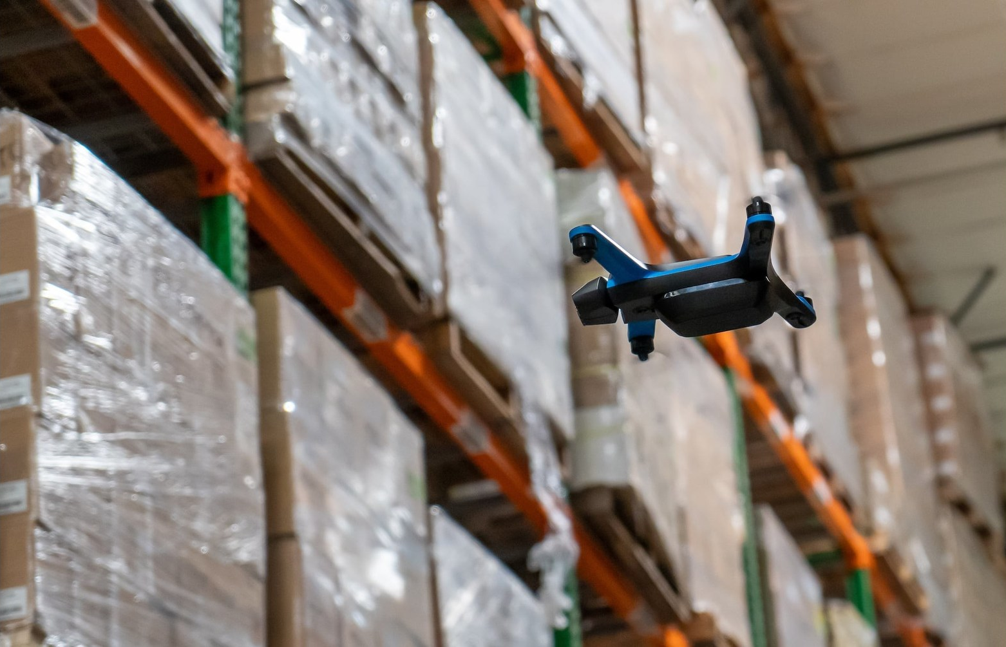
Solution
Use a drone with cameras to scan items
Can be easily expanded (cost effective)
Provides much more information (i.e. image of location)
Requires a well-lit environment or night vision cameras

Slide 4
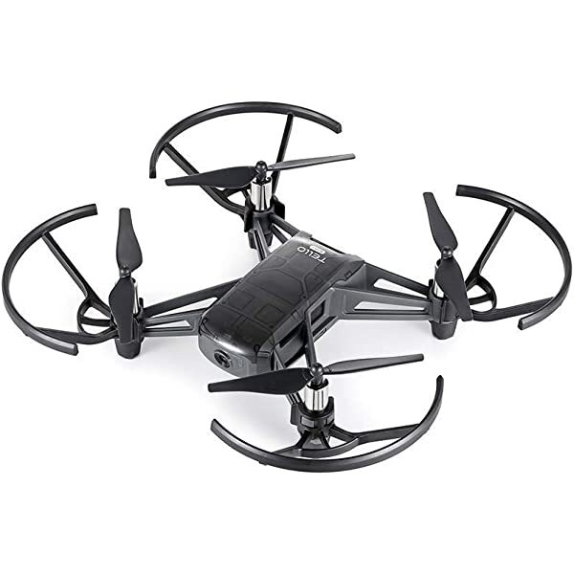
DJI Ryze Tello EDU
Low cost ($129)
Cheap to repair/replace
Swappable batteries, can buy spares
Python API
Stream camera feed into OpenCV
Send movement commands
Safe
Integrated propeller guards
Low power/speed
Performance
13 minute flight time
Onboard Intel processor

Slide 5
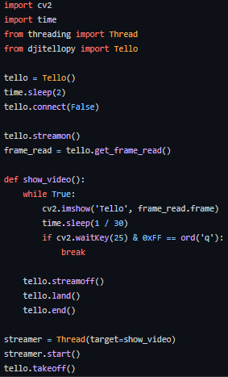
Programming with Tello
Tello SDK
Connect to drone over WiFi
Takeoff, land, move in flight
Camera streaming
Tested in Python
Code on our GitHub repository
Successfully streamed camera
Commanded drone to takeoff
Notes:
Vidit

Slide 6
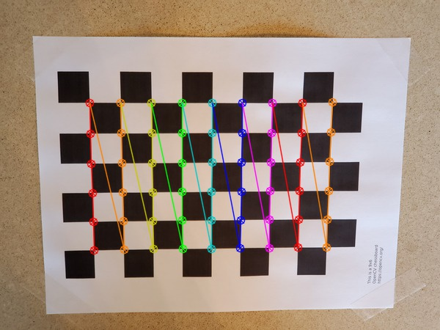
Camera Calibration
Is needed to use AruCo markers to estimate distance
Estimates distortion causes by optics, allows for undistorting the image
Have completed calibration, and validated results
Notes:
Niha Yendamuri

Slide 7
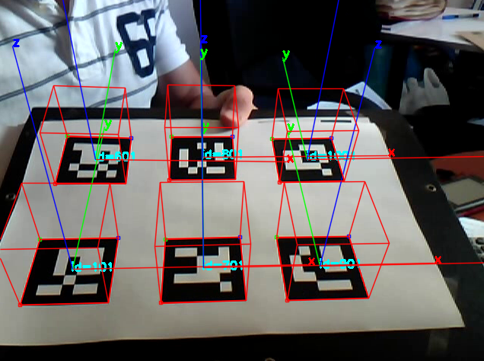
AruCo Markers
Uses
Estimate position of drone
Identify locations in warehouse
Map locations to items
4 markers in corners of each bay on shelf
Each marker corresponds to integer ID
Tuple of 4 IDs used as key in database for location of scanned items
Notes:
Prabhav Gupta

Slide 8
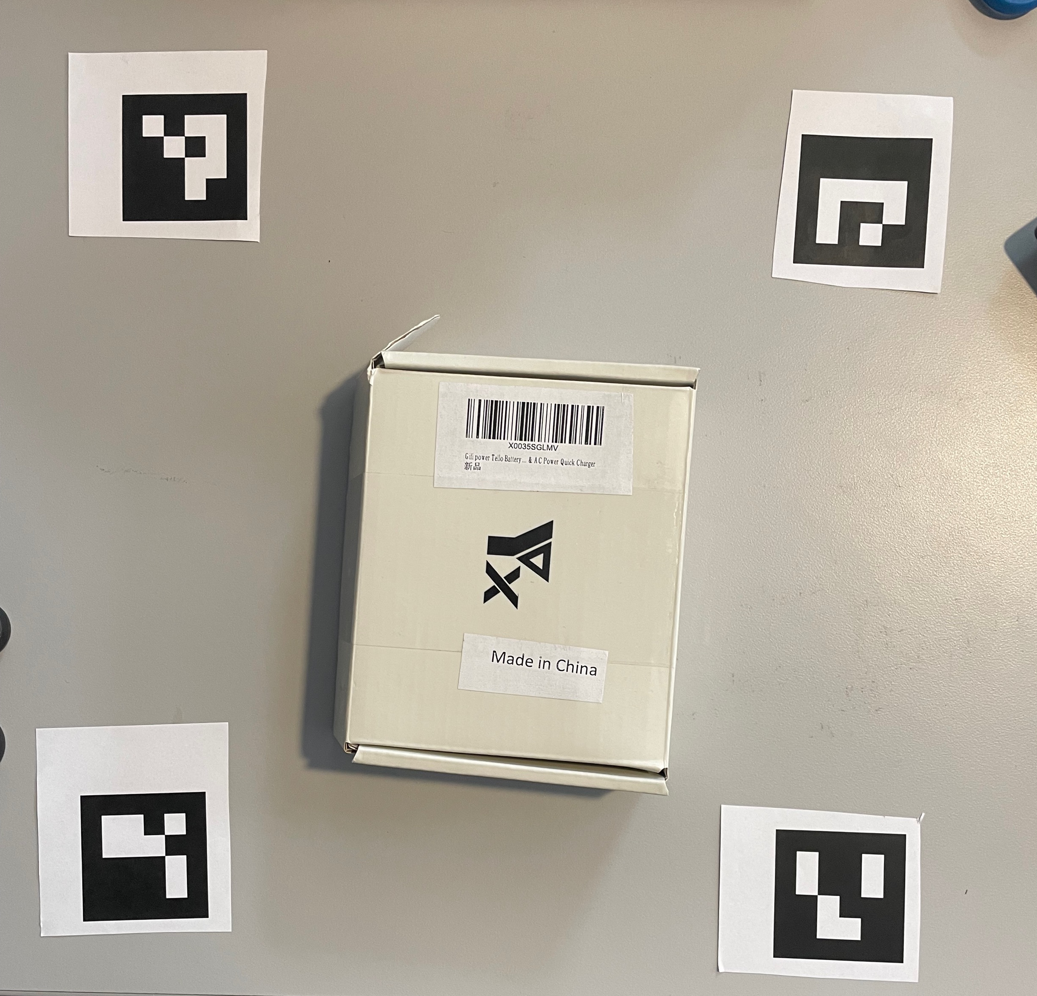
Barcode Scanning
Pyzbar library
Free and open source
Scans QR codes and barcodes
Warehouse doesn’t need to redo all their barcodes
Works with OpenCV
Can pass in drone frames
Issues
Resolution on drone too low

Slide 9



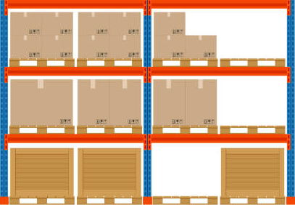
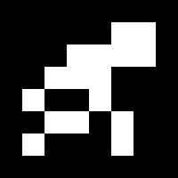

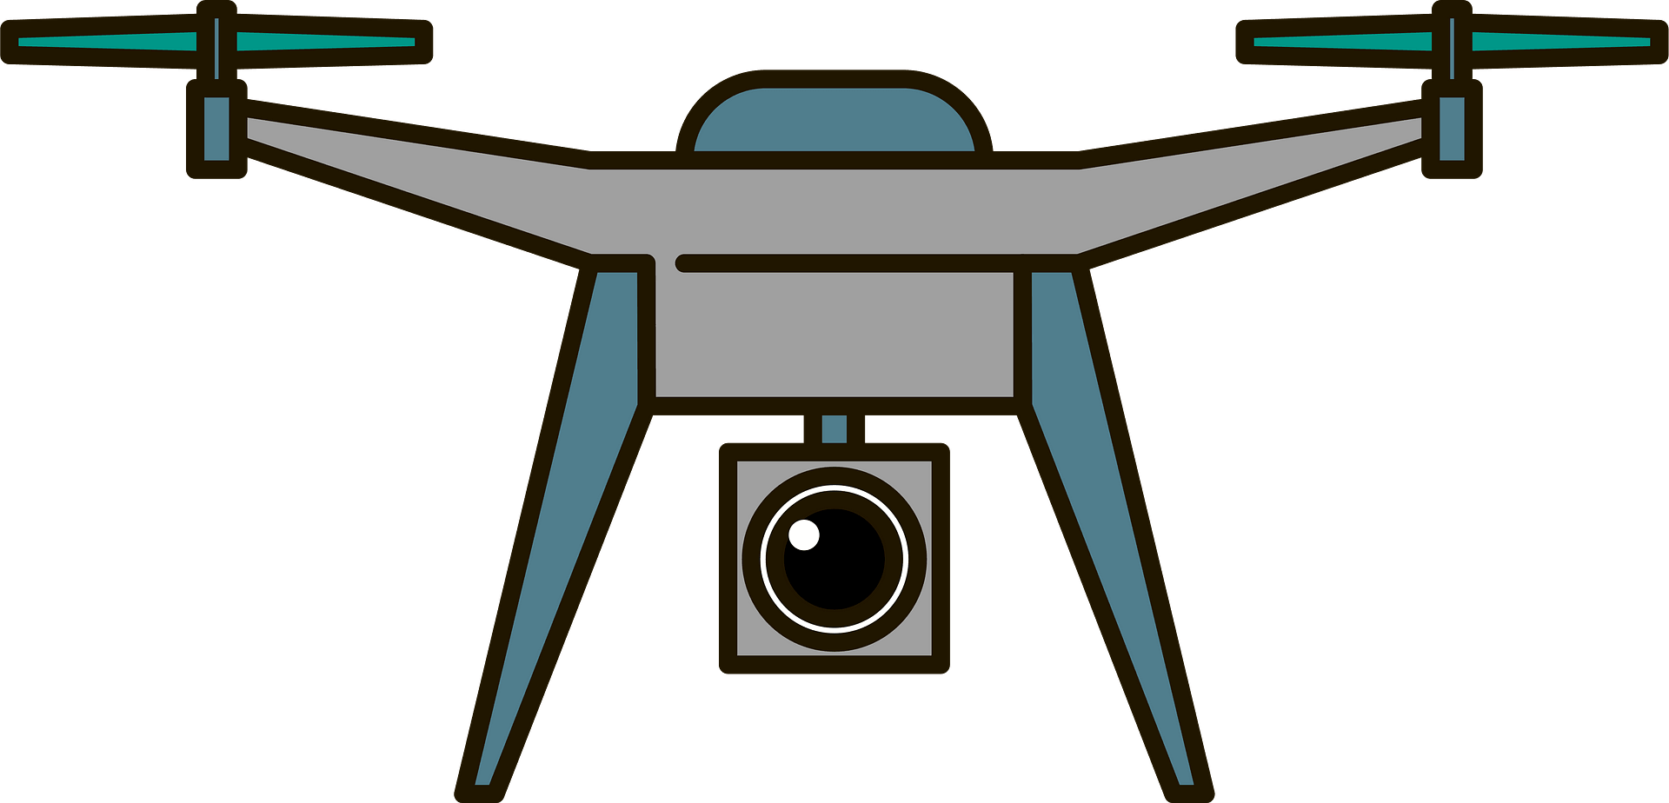
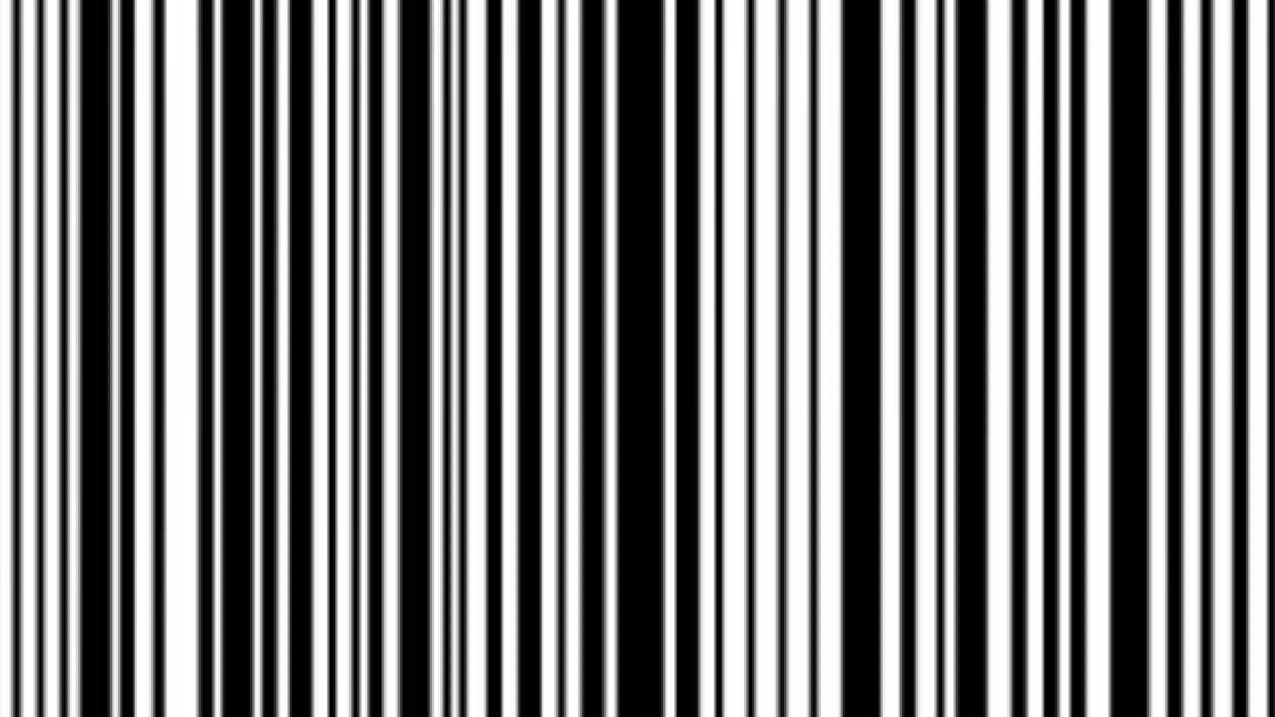
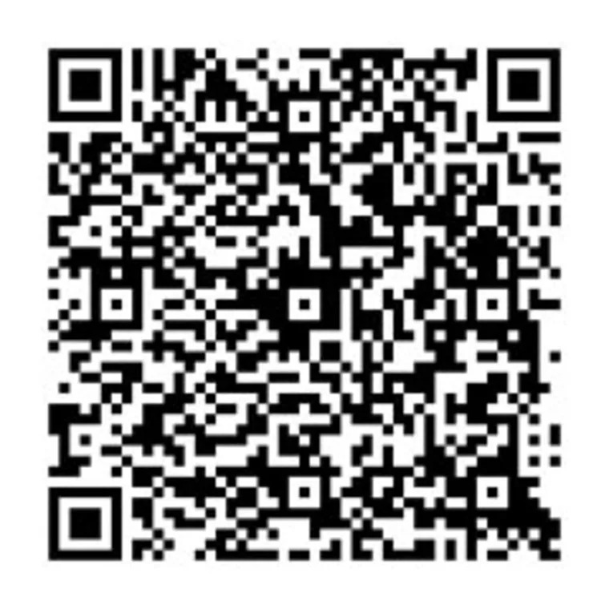
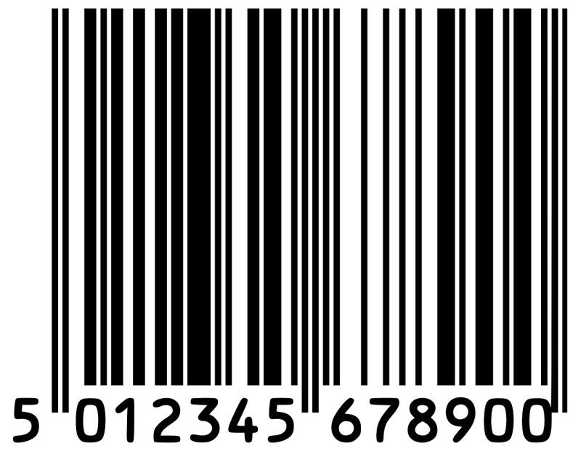
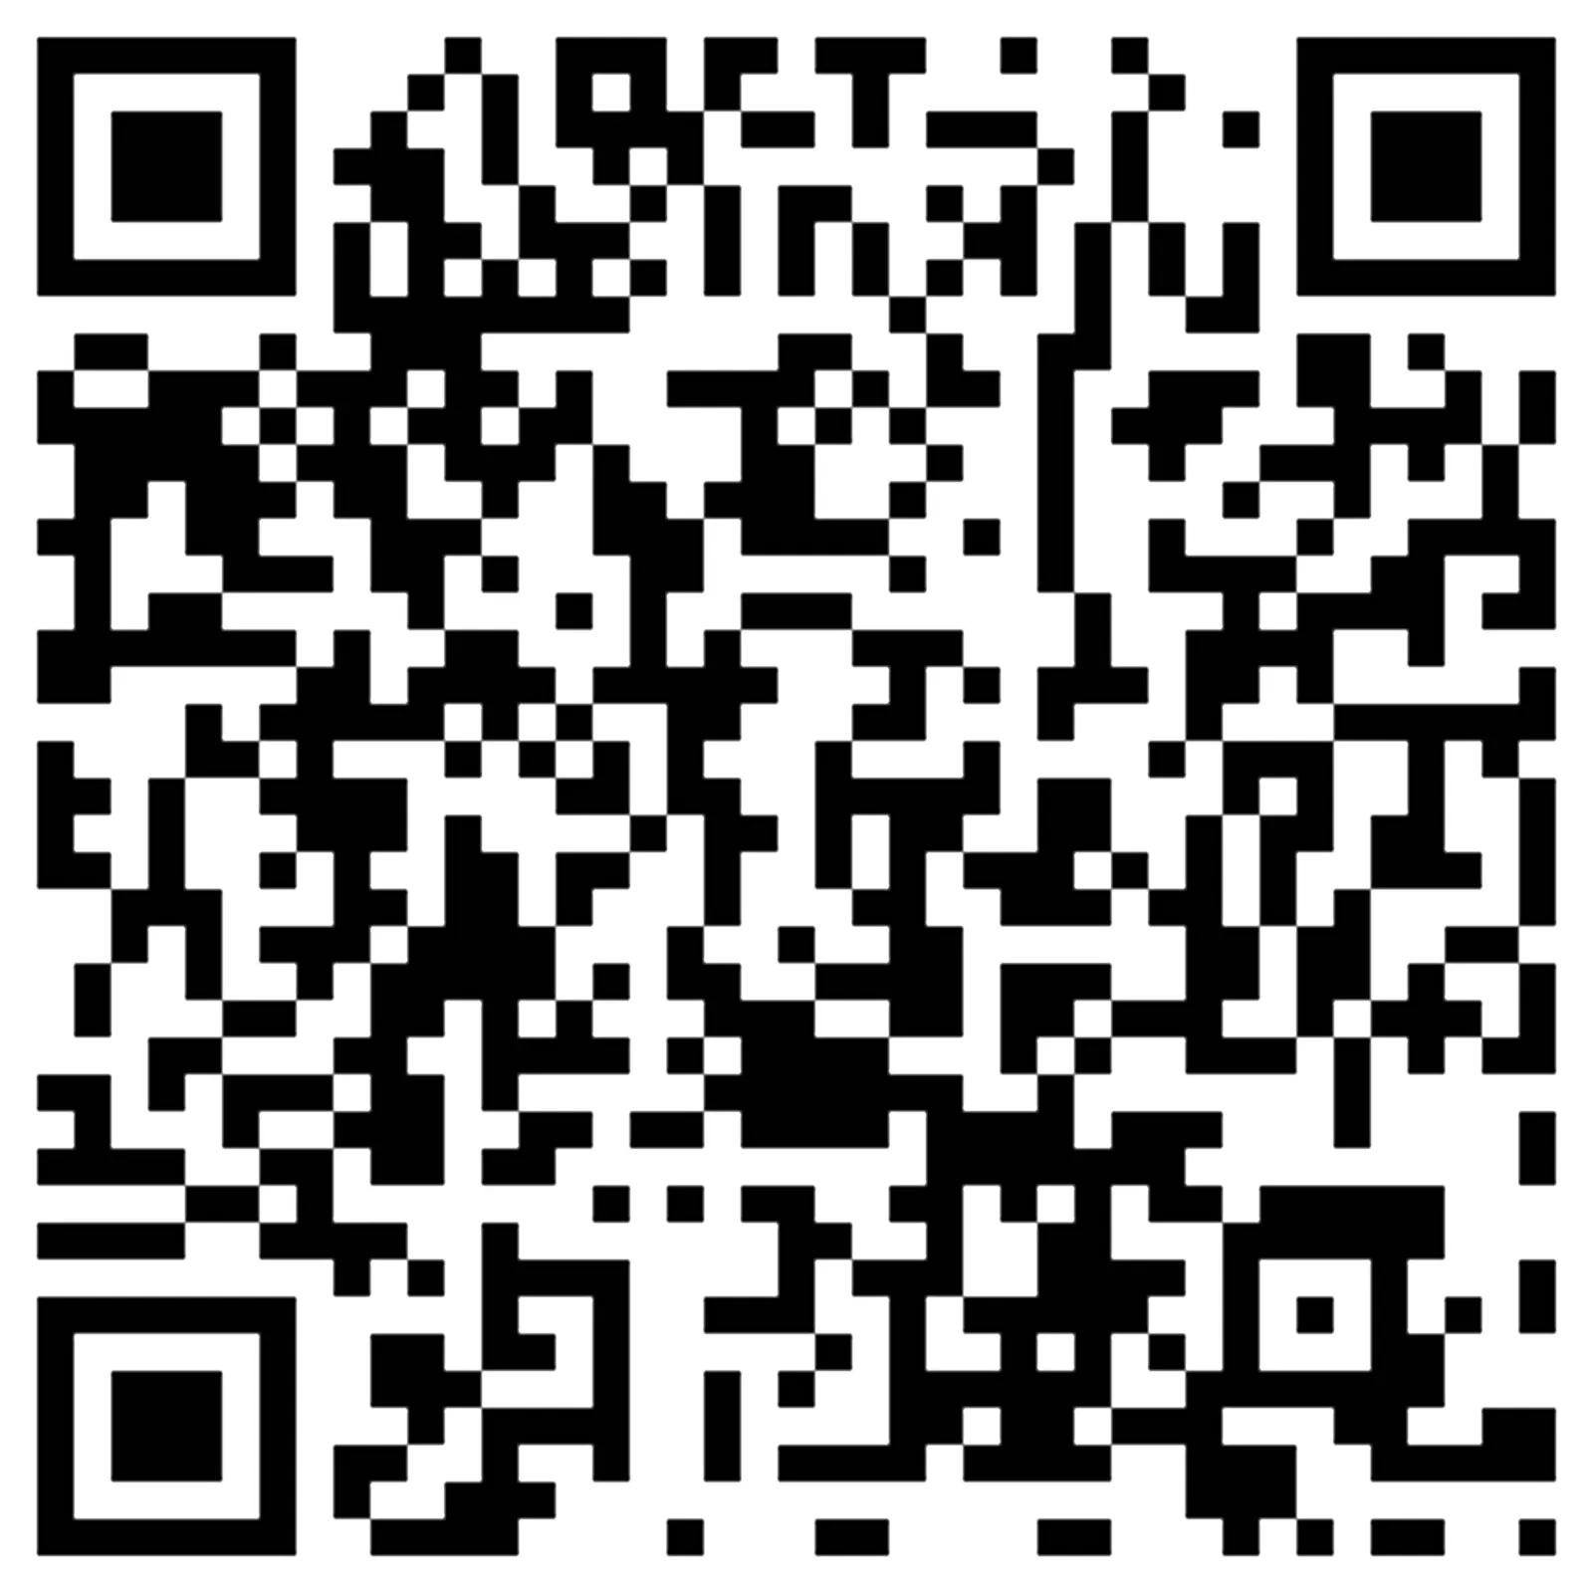
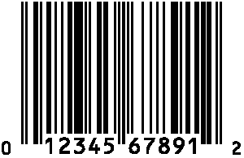
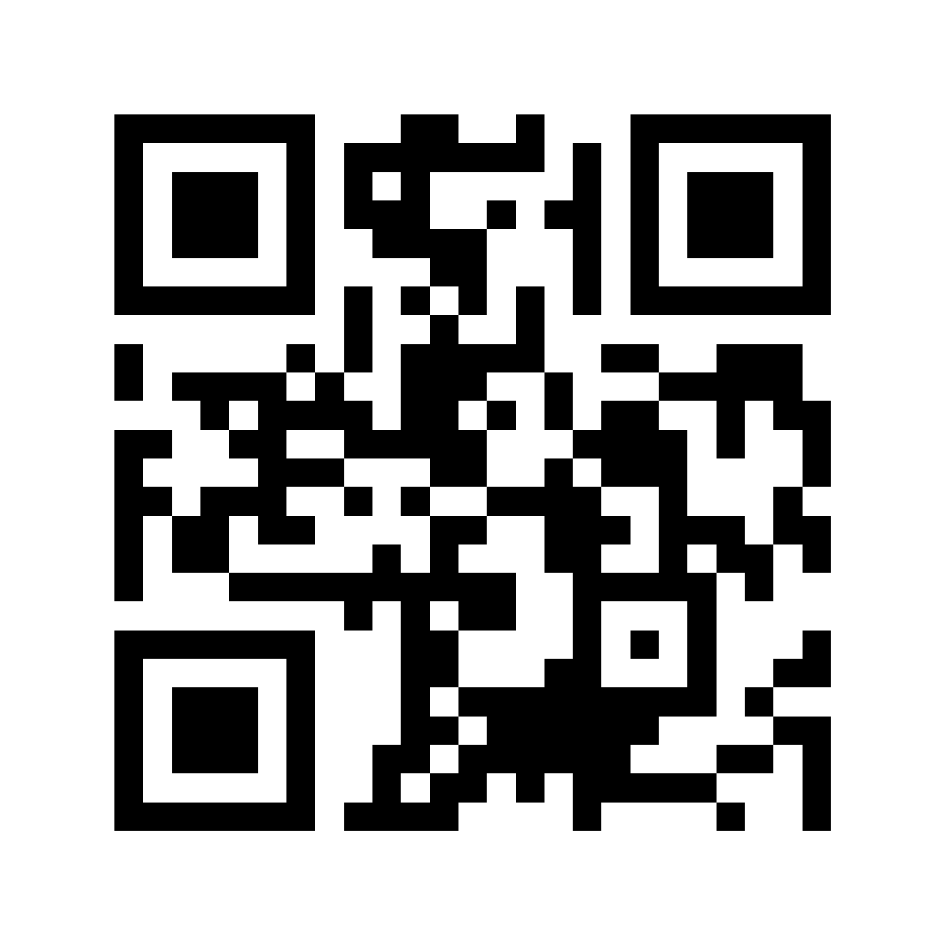
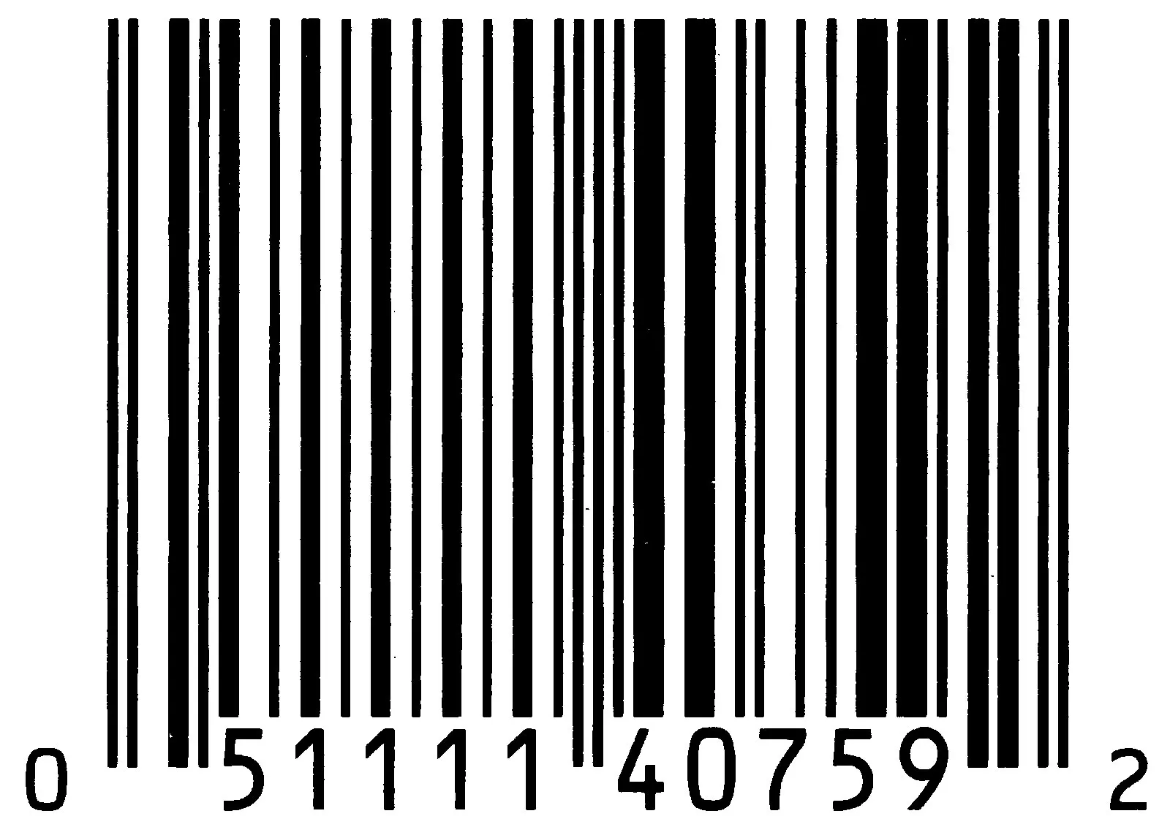
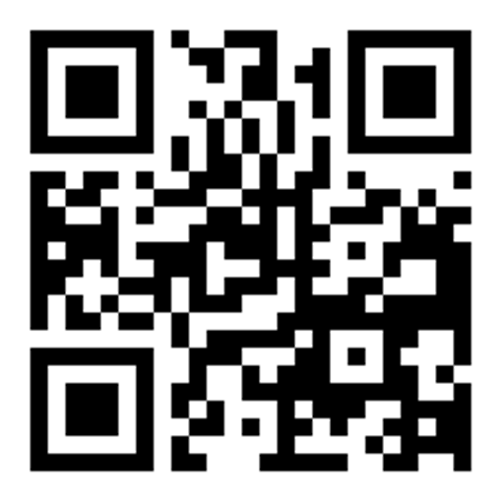
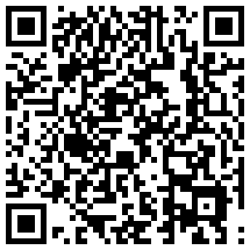
Scanning Routine
Items identified by QR codes or barcodes
Drone sweeps across a single wall of shelves
Locations on shelves identified by AruCo markers
Return to base station after scanning

Slide 10
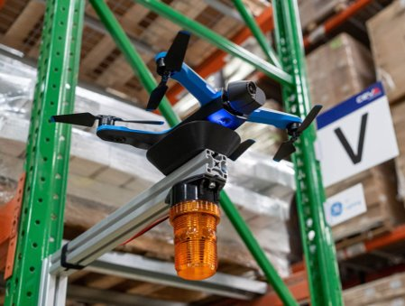
Drone Power
Charging
Use Qi receivers and charging pads to recharge drone
Charging pads at each base station, near a shelf
Low cost and easy to start
Remote start/stop
"Press" the power button of the drone using a microcontroller
Needs to be lightweight, have wireless connectivity
Could be powered by same wireless charging circuit
Notes:
Mithun

Slide 11
Next Steps
Finish calibration
Test with AruCo markers
Try to fly drone using markers for guidance
Stretch: mimic scanning routine
Start work on drone power
Buy microcontrollers and other hardware
Test modifications to the drone
Stretch: precision landing on pad

Slide 12
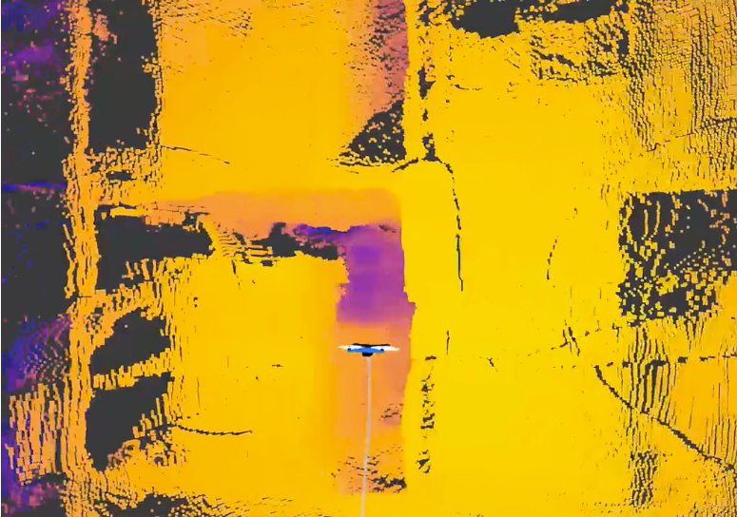
Future Goals
SLAM
Localization of drone
Mapping of warehouse
Multiple drones
Controlling a swarm
Shared map and positioning

Slide 13
Scanning Routine
Items identified by QR codes or barcodes
Drone sweeps across a single wall of shelves
Locations on shelves identified by AruCo markers
Return to base station after scanning
Notes:
Rahul Katre

Slide 14
Scanning Routine
Items identified by QR codes or barcodes
Drone sweeps across a single wall of shelves
Locations on shelves identified by AruCo markers
Return to base station after scanning

Slide 15
Scanning Routine
Items identified by QR codes or barcodes
Drone sweeps across a single wall of shelves
Locations on shelves identified by AruCo markers
Return to base station after scanning

Slide 16
Scanning Routine
Items identified by QR codes or barcodes
Drone sweeps across a single wall of shelves
Locations on shelves identified by AruCo markers
Return to base station after scanning

Slide 17
Scanning Routine
Items identified by QR codes or barcodes
Drone sweeps across a single wall of shelves
Locations on shelves identified by AruCo markers
Return to base station after scanning

Slide 18
Scanning Routine
Items identified by QR codes or barcodes
Drone sweeps across a single wall of shelves
Locations on shelves identified by AruCo markers
Return to base station after scanning

Slide 19
Scanning Routine
Items identified by QR codes or barcodes
Drone sweeps across a single wall of shelves
Locations on shelves identified by AruCo markers
Return to base station after scanning

Slide 20
Scanning Routine
Items identified by QR codes or barcodes
Drone sweeps across a single wall of shelves
Locations on shelves identified by AruCo markers
Return to base station after scanning

Slide 21
Scanning Routine
Items identified by QR codes or barcodes
Drone sweeps across a single wall of shelves
Locations on shelves identified by AruCo markers
Return to base station after scanning

Slide 22
Scanning Routine
Items identified by QR codes or barcodes
Drone sweeps across a single wall of shelves
Locations on shelves identified by AruCo markers
Return to base station after scanning

Slide 23
Scanning Routine
Items identified by QR codes or barcodes
Drone sweeps across a single wall of shelves
Locations on shelves identified by AruCo markers
Return to base station after scanning

Slide 24
Scanning Routine
Items identified by QR codes or barcodes
Drone sweeps across a single wall of shelves
Locations on shelves identified by AruCo markers
Return to base station after scanning

Slide 25

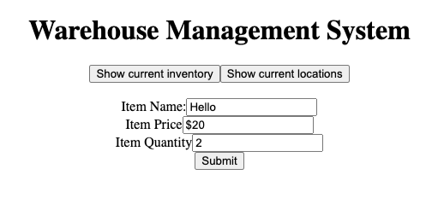
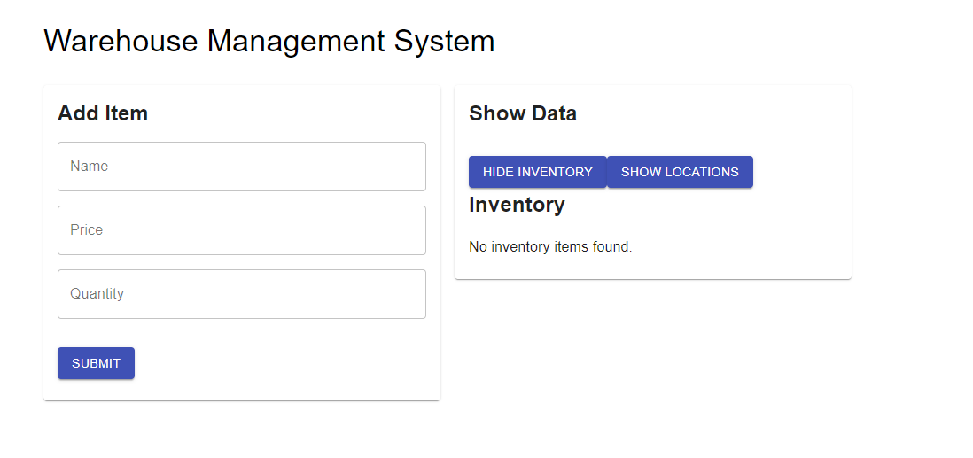
Warehouse Management System (WMS) Front-End Material UI Integration
Integration of Material UI
Main pro of using this design system is due to its ease of use, flexibility, and performance
Access to pre-built and customizable UI components that follow Google's Material design guidelines
UI interactions are compatible with Firebase

Slide 26
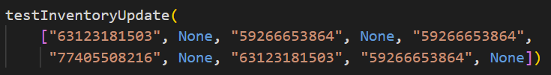
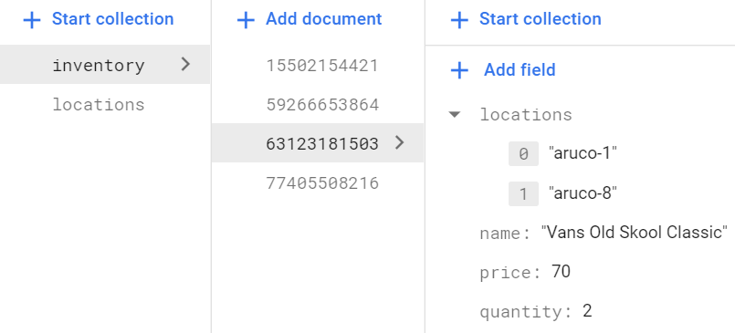
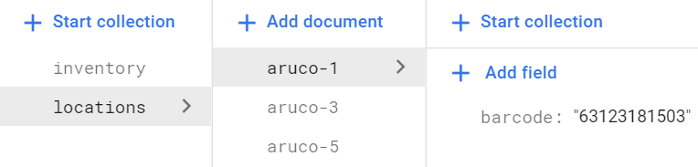
Warehouse Management System (WMS)
Implemented using Firebase (NoSQL database)
Database has 2 collections:
Mapping of location to item at location
Mapping of item to locations where it is
Location determined by scanned AruCo markers
Made working demo that updates both collections as the drone scans
Supports standard WMS queries
Notes:
Prakhar

Slide 27
Current WMS Steps
Working on python script to test functionality of the rest API on Firebase
API should be able to send valuable information
Package location
Date of item entry
Current stock of any item
Helpful with making sure the Machine Learning team has something to interface with
Will be migrating system to SQL using postgreSQL
Rest API testing will still be useful after migration

Slide 28
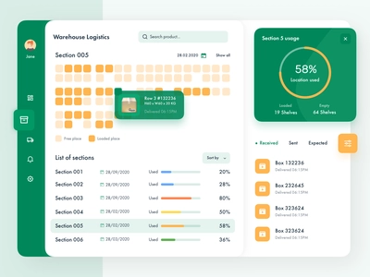
WMS Front-End Requirement Overview
Requirements:
Button to start scan
Button to end scan
Statistics panel
Authentication
Nice-to-have:
Adjustable scan speed
Adjustable scan path
Notes:
Sai M

Slide 29
WMS Front-End Requirements (cont.)
Statistics Panel
List of products in stock w/ quantities
Locations of products
Changes in quantity over time (between subsequent scans)
Date added
Inconsistencies between drone scanning data and other data (if available)
Additional features
Suggestions for warehouse organization and restructuring to optimize core business processes
Cost-saving measures based on business requirements and client needs
Drone Use Statistics
Data that indicates how, where, when, and how often the drone is being used
Wear and tear info based on maintenance records
Can be passed into an ML model to plan future drone usage to reduce maintenance and other drone-related costs
Visualizations of drone usage for non-technical personnel and for marketing purposes
Notes:
Shivank

Slide 30

Django for backend framework
Native admin page with minimal setup cost
Consistent architecture for this so will be easy to divvy up tasks and maintain consistency
Model View Template Architecture (MVT)
Models help developers to create, read, update, and delete objects (CRUD operations) in the original database. Also, they hold business logic, custom methods, properties, and other things related to data manipulation.
The View is used to execute the business logic and interact with a model to carry data and renders a template. The view fetches data from a model. Then, it either gives each template access to specific data to be displayed, or it processes data beforehand.
The Template is a presentation layer that handles the User Interface part completely. These are files with HTML code, which is used to render data. The contents of these files can be static or dynamic. A template is used only to present data since there’s no business logic in it.
MVT uses data (Model), layout (Template), and logic (View)
The framework has protection against the most common security attacks like XSS and CSRF (Cross-Site Request Forgery) attacks, SQL injections, Clickjacking, etc.
The user authentication system of Django is also solid and manages usernames and passwords.
Django has great libraries
Django REST framework is responsible for building application programming interfaces
Django is highly secure
Handles encryption natively

Slide 31
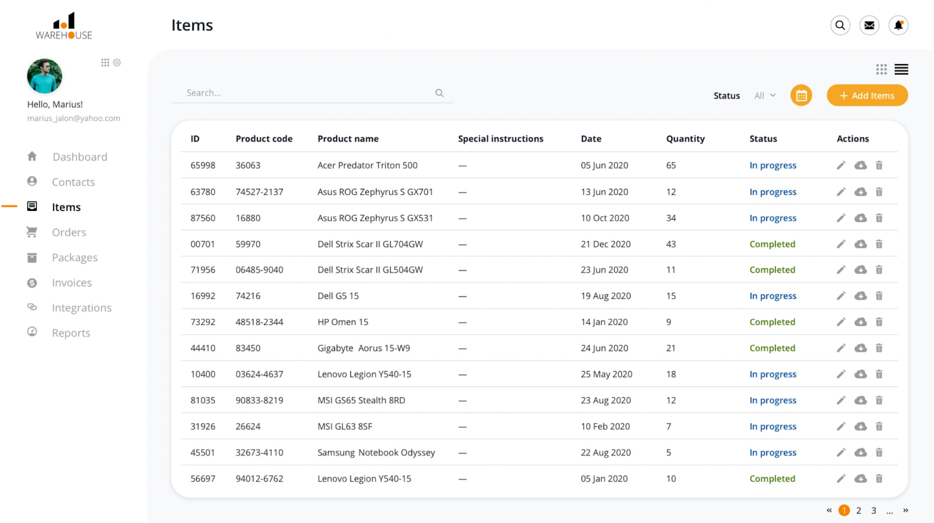
WMS Database Structure
In each WMS system has all items listed in a database; each item is given a unique product code that identifies what a specific item is.
In this system there are ID, Product code, Product name, Special instructions, Status (in progress, completed), Date, Quantity, and Actions. We can customize the database to have what we want.
This is a good way of how we can structure our SQL database, it has everything that we are looking for.

Slide 32
Drone-Based Inventory Management
Questions
Notes:
Rahul Katre

